Slide 1
Building Learning Analytics Ecosystems resources for this workshop:
Kirsty Kitto
Connected Intelligence Centre
@ KirstyKitto • www.beyondlms.org • Kirsty.kitto@uts.edu.au
utscic.edu.au

Slide 2
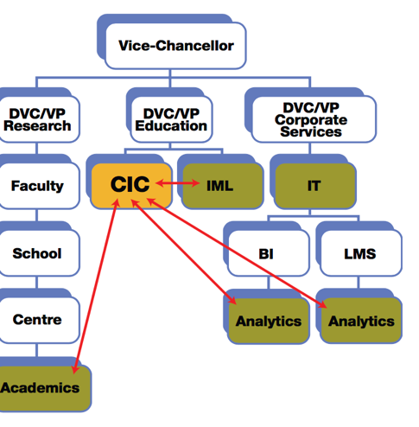
what is UTS:CIC?
Connected Intelligence Centre
UTS innovation lab specialising in Learning Analytics
provides in house data science consultancy
academics teach data science and perform research
trains PhDs in Learning Analytics
Buckingham Shum, S., & Mckay, T. (2018). Architecting for Learning Analytics: Innovating for Sustainable Impact. Educause Review, 53(2), 25-37.

Slide 3
what is a LA ecosystem?

Slide 4
where does learning happen?

Slide 5
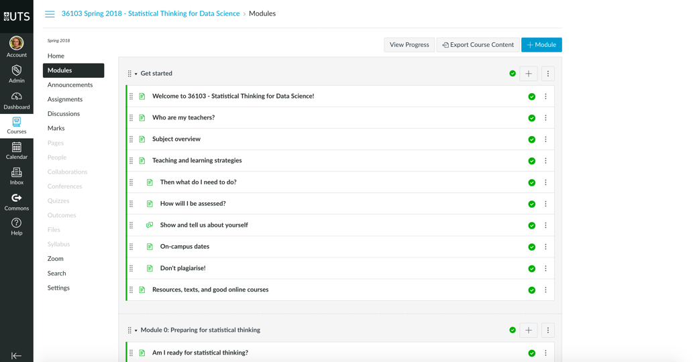
traditionally EdTech has focused upon learning in the confines of systems it builds…

Slide 6
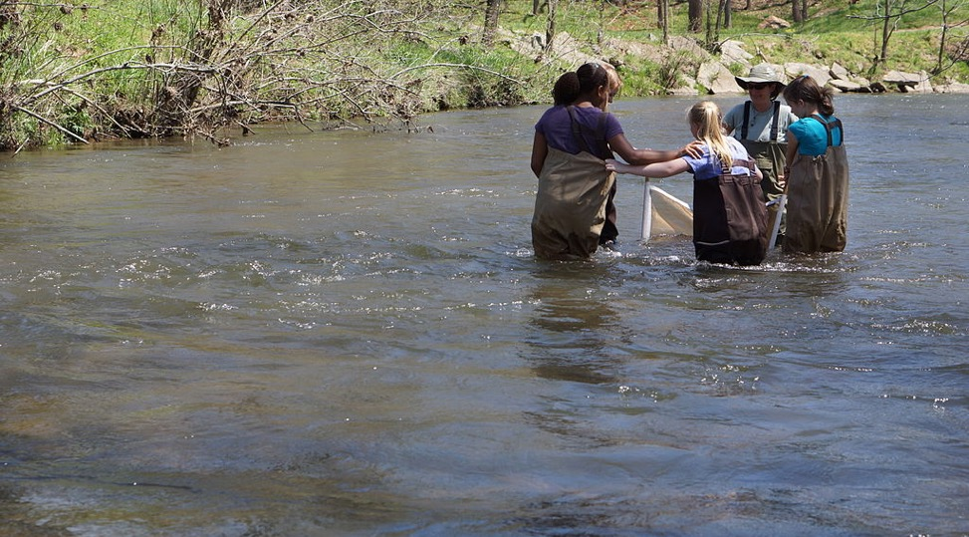
but learning happens everywhere!
https://commons.wikimedia.org/wiki/File:Andrea_Leslie_helps_students_search_(8696541130).jpg

Slide 7
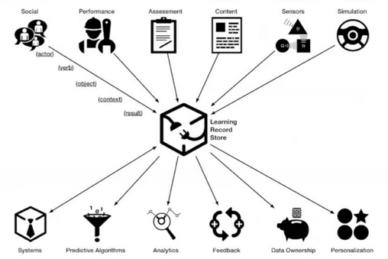
finally new data standards have emerged…
…new possibilities for capturing and using data!
https://www.apereo.org/communities/learning-analytics-initiative/learning-analytics-webinar-state-xapi-and-imsglobal

Slide 8
but does that matter to us?

Slide 9
yes!
data needs to flow across boundaries if LA is going to support lifelong learning…
the education sector has notorious problems with
RPL
data portability
personalisation
…and don’t forget Ryan Baker’s first grand challenge from LAK’19

Slide 10
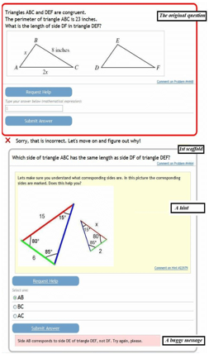
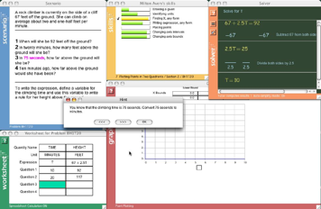
1. Transferability: The (learning system) Wall
From Ryan Baker’s keynote:
http://radix.www.upenn.edu/learninganalytics/BLAP/LAK-2019-keynote-v6.pptx

Slide 11
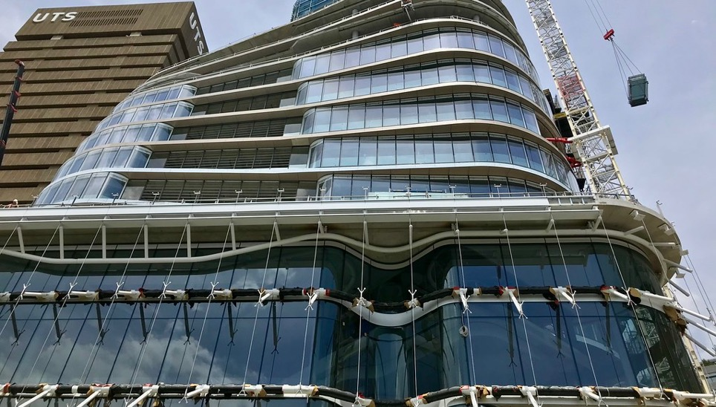
as LA practitioners we will increasingly have to design and build data ecosystems…
…this brings a number of challenges

Slide 12
where are we going today?
what is a LA ecosystem?
your present reality and visions for the future
a flying introduction to xAPI
data interoperability
poor data (and how to fix it)
pick a challenge!

Slide 13
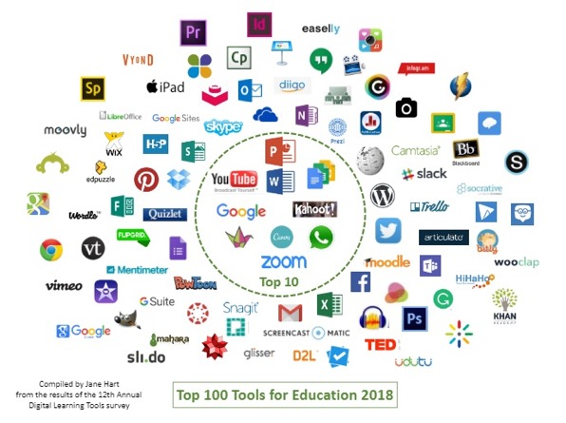
section 1: what is a LA ecosystem?
we can start to answer this question by thinking about our learning ecosystems…
here is a map of the tech tools commonly used in education
how are we going to deliver LA over that type of complexity?
https://www.toptools4learning.com/

Slide 14
example: the LA ecosystem that I am currently working on at UTS

Slide 15
what affects LA ecosystems?
“The future of learning analytics depends to a large extent on the policy adopted by institutions and governments. Its practice will be greatly shaped by the regulatory framework which is established, the investment decisions made, the infrastructure and specifications which are promoted, and the educational discourse.”
Buckingham Shum, S., 2015. Writing analytics and the LAK15 “State of the Field” panel (20 March 2015). Simon.BuckinghamShum.net. Available at: http://simon.buckinghamshum.net/2015/03/writing-analytics-lak15-panel/

Slide 16
what affects LA ecosystems?
“The future of learning analytics depends to a large extent on the policy adopted by institutions and governments. Its practice will be greatly shaped by the regulatory framework which is established, the investment decisions made, the infrastructure and specifications which are promoted, and the educational discourse.”
Buckingham Shum, S., 2015. Writing analytics and the LAK15 “State of the Field” panel (20 March 2015). Simon.BuckinghamShum.net. Available at: http://simon.buckinghamshum.net/2015/03/writing-analytics-lak15-panel/

Slide 17
so we have to work within constraints...
to deliver viable solutions

Slide 18
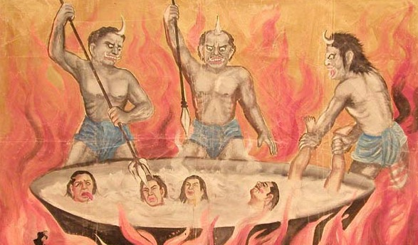
section 2: your present reality and visions for the future

Slide 19
what is your current data reality?
never
sometimes
all the time
I do LA
I can get ethics approval to do my research
I get access to my institution’s data
my institution can actually give me all of the relevant data I need
my institution purchases products that do not give us access to the data they generate
my institution has a data policy which helps me do LA
my institution has a clear vision for the future of how it will use LA

Slide 20
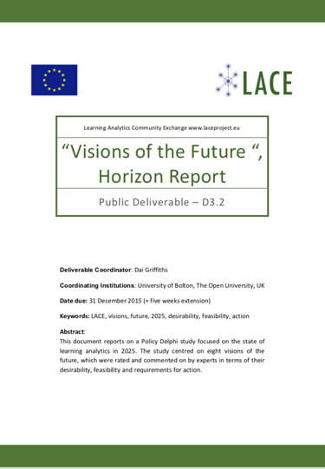
LACE visions of the future
In 2025…
classrooms monitor the physical environment to support learning and teaching
personal data tracking supports learning
analytics are rarely used in education
individuals control their own data
open systems for LA are widely adopted
LA systems are essential tools of educational management
most teaching is delegated to computers
analytics support self-directed learning
Ferguson, Rebecca and Brasher, Andrew and Clow, Doug and Griffiths, Dai and Drachsler, Hendrik (2016). Learning analytics: visions of the future. LACE Technical Report, Workpackage D3.2, http://laceproject.eu/wp-content/uploads/2016/02/LACE_D3_2.pdf

Slide 21
activity: what is your vision?
form into groups of ~4
you have 5 minutes to discuss:
how would you like LA to be used?
do you have concerns about how it might get misused?
is your vision different from your employer’s?
NB: someone from your group will have to report back!
don’t forget to have a look at the LACE report:
http://laceproject.eu/wp-content/uploads/2016/02/LACE_D3_2.pdf

Slide 22
mapping out your reality… (how will you achieve your vision?)
form into groups of 2
open up this link: https://bit.ly/2Kl2nx7
what systems might you have to build LA for at your institution?
work out what data they have… look it up if you don’t know!
fill in the spreadsheet (one for each person)

Slide 23
section 3: a flying introduction to xAPI

Slide 24
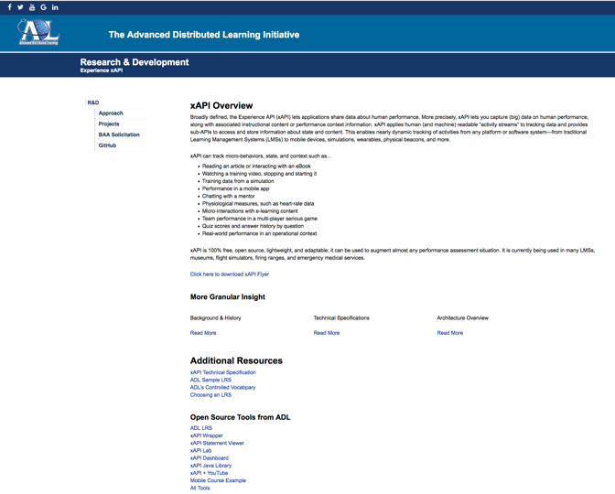
xAPI
a data specification (2013)
https://github.com/adlnet/xAPI-Spec
initially meant as a successor to SCORM
very flexible to use
has simple required syntax (actor, verb, object)
open source with open development model… anyone can contribute to what is a community effort

Slide 25
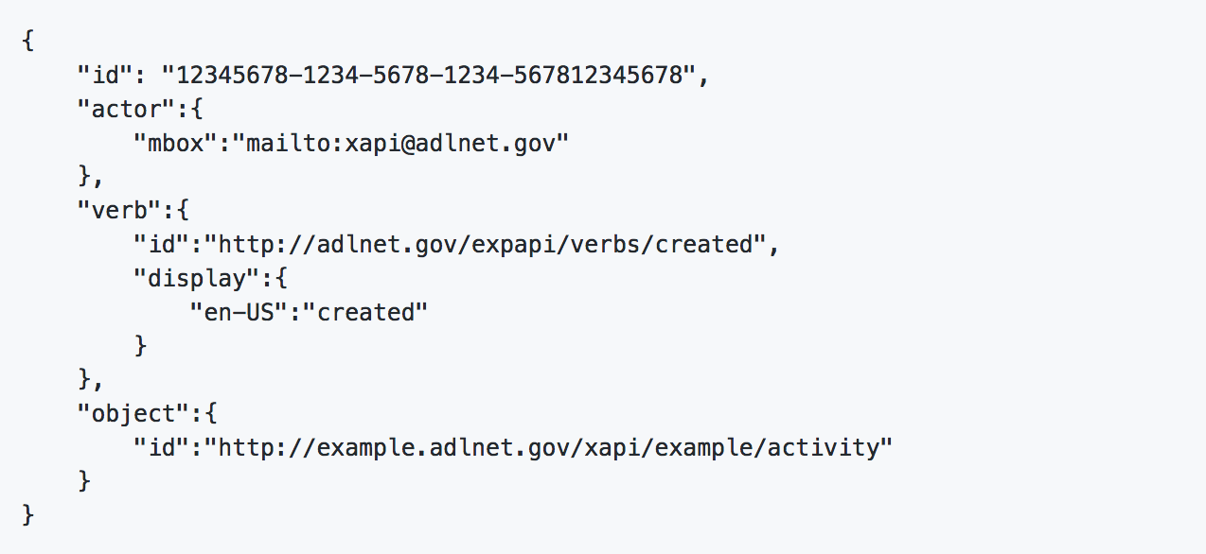
a simplest possible legal xAPI statement
(we will see some more realistic examples soon)

Slide 26
Learning Record Providers (LRPs)

Slide 27
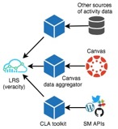
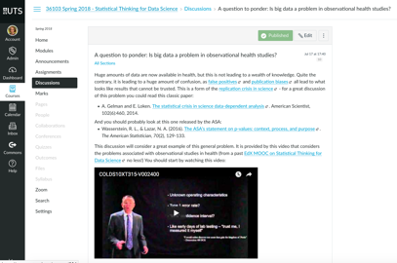
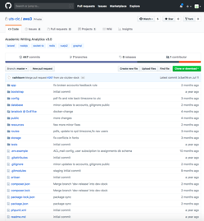
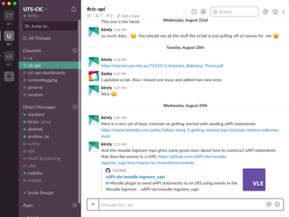
what is a learning record provider? (LRP)
something that monitors a learner
extracts data about what they are doing
creates an xAPI statement
and sends it to a Learning Record Store (LRS)

Slide 28
an example?

Slide 29
ID14-3821: ENABLING CONNECTED LEARNING VIA OPEN SOURCE ANALYTICS IN THE WILD: LEARNING ANALYTICS BEYOND THE LMS This project was supported by the Australian Government’s office for learning and teaching
QUEENSLAND UNIVERSITY OF TECHNOLOGY: Kirsty Kitto (Lead Investigator), Mandy Lupton, John Banks, Dann Mallet, Peter Bruza
UNIVERSITY OF SOUTH AUSTRALIA Shane Dawson, Dragan Gašević (Uni of Edinburgh)
UNIVERSITY OF TECHNOLOGY SYDNEY Simon Buckingham Shum (and now Kirsty Kitto!)
UNIVERSITY OF SYDNEY Abelardo Pardo
UNIVERSITY OF TEXAS (ARLINGTON) George Siemens
final report now available!
see www.beyondlms.org

Slide 30
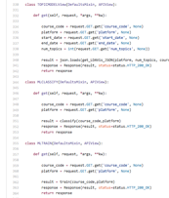
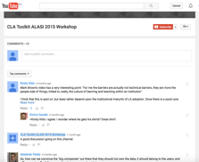
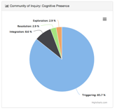
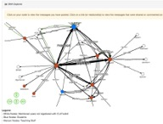
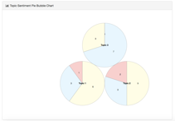
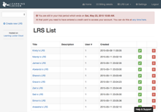
the connected learning analytics toolkit
Learning
Record Store
xAPI
scraping
analysis
social media
learning analytics
students
academics
admin & developers
Kitto, K., Cross, S., Waters, Z., Lupton, M. (2015). Learning Analytics beyond the LMS: the Connected Learning Analytics Toolkit. In Proceedings of the Fifth International Conference on Learning Analytics and Knowledge (LAK15). ACM, New York, NY, USA, 11-15.

Slide 31
CLA toolkit V2
no dashboards reports!
it just collects data and sends it to the LRS
maintains modularity
trello, slack, twitter, GitHub integrations
a second suite of tools are used to deliver LA, dashboards, and other tools (e.g. piping data to OnTask)
http://www.beyondlms.org/tools/CLAtoolkit/ has more information

Slide 32
you will get to build one in a minute!!!

Slide 33
Learning Record Stores (LRSs)

Slide 34
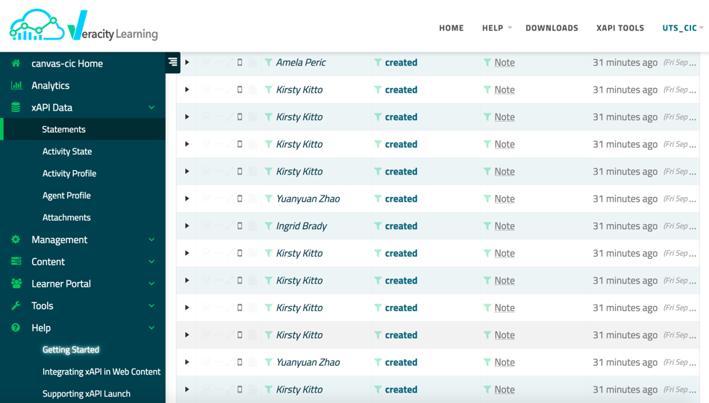

Slide 35
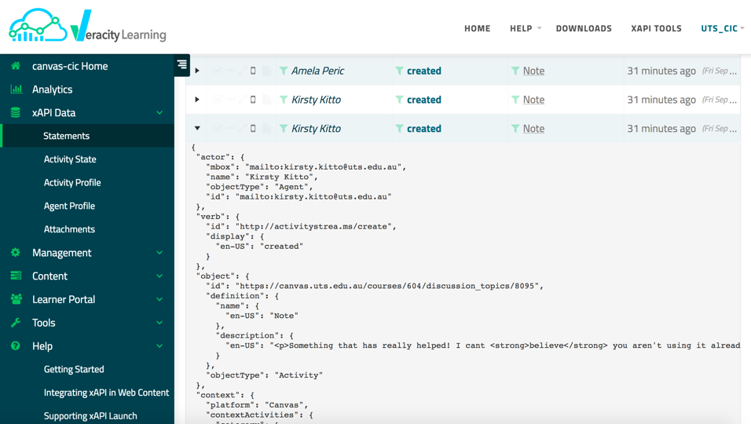

Slide 36
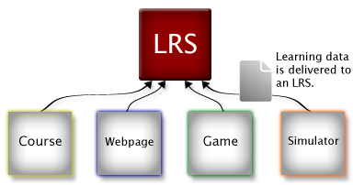
learning record stores (LRS)
accept and send xAPI statements!
the specification is very clear about how these must behave
but different vendors often enhance their LRS with further functionality (especially in its analytics and reporting capabilities)
quite a few vendors have a free service:
Veracity: https://lrs.io/
HT2 (LearningLocker): https://www.ht2labs.com/learning-locker/
Rustici (Watershed): https://www.watershedlrs.com/product/pricing/essentials-learning-record-store

Slide 37
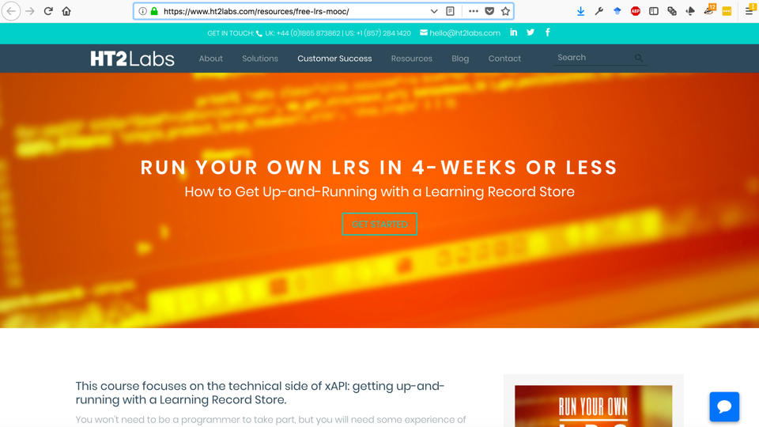

Slide 38
creating statements to use in LRPs

Slide 39
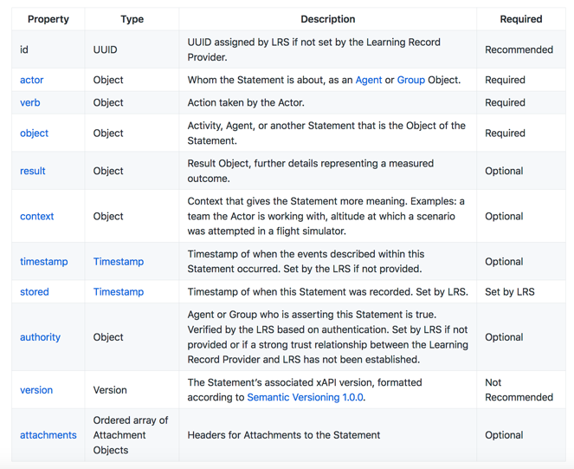
statement properties
https://github.com/adlnet/xAPI-Spec/blob/master/xAPI-Data.md#statement-properties

Slide 40
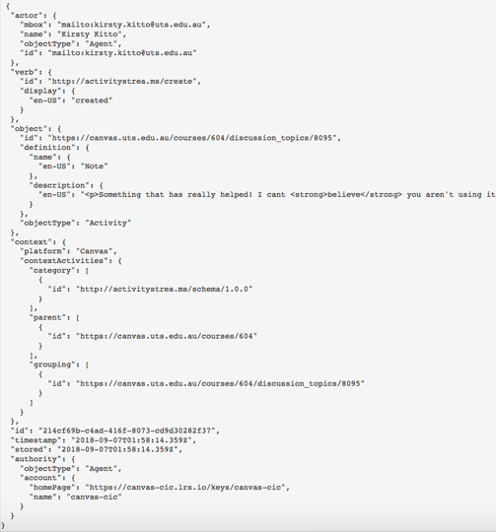
a more realistic example xAPI statement (but its still very simple!)
you can find more examples at:
https://github.com/adlnet/xAPI-Spec/blob/master/xAPI-Data.md#Appendix2A

Slide 41
a more realistic example xAPI statement (but its still very simple!)
you can find more examples at:
https://github.com/adlnet/xAPI-Spec/blob/master/xAPI-Data.md#Appendix2A

Slide 42
actors
Actor: An individual or group performing an action within an Activity
Individual: Agent
Group: Group
an actor is the “I” in “I did this”
they are the thing doing the learning!

Slide 43
actors can have many different roles – termed persona

Slide 44
a more realistic example xAPI statement (but its still very simple!)
you can find more examples at:
https://github.com/adlnet/xAPI-Spec/blob/master/xAPI-Data.md#Appendix2A

Slide 45
verbs
define the action between an Actor and an Activity
the specification does not define verbs
instead, it defines how to create verbs so that communities of practice can establish verbs meaningful to their members and make them available for use by anyone…
new xAPI profile specification helps… more on this shortly

Slide 46
a more realistic example xAPI statement (but its still very simple!)
you can find more examples at:
https://github.com/adlnet/xAPI-Spec/blob/master/xAPI-Data.md#Appendix2A

Slide 47
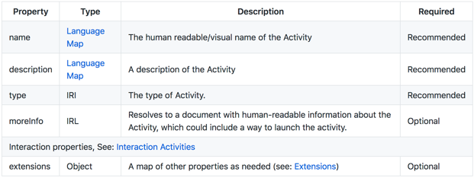
objects
define the thing acted on:
Activity
Agent/Group
SubStatement
StatementReference

Slide 48
a more realistic example xAPI statement (but its still very simple!)
more on this after lunch
you can find more examples at:
https://github.com/adlnet/xAPI-Spec/blob/master/xAPI-Data.md#Appendix2A

Slide 49
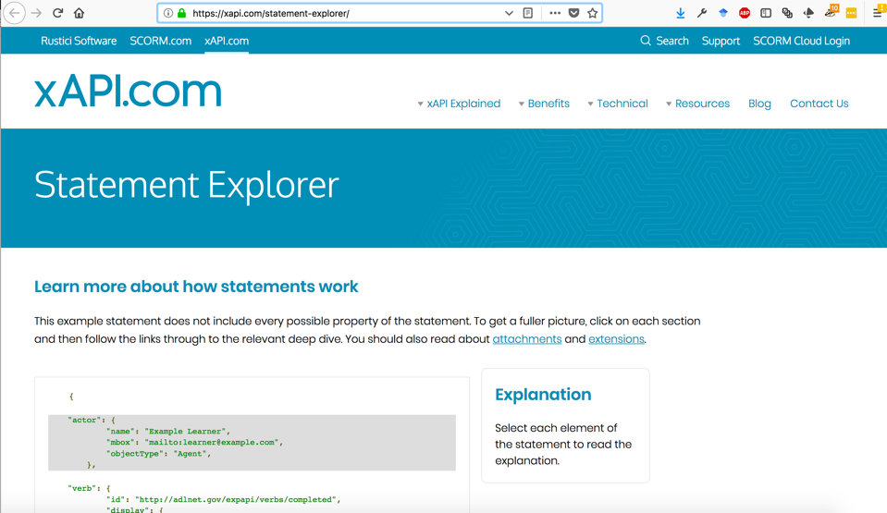

Slide 50
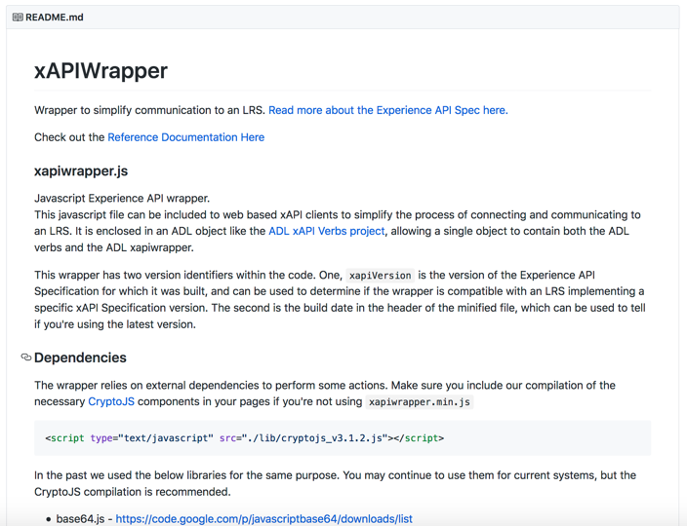
https://github.com/adlnet/xAPIWrapper

Slide 51
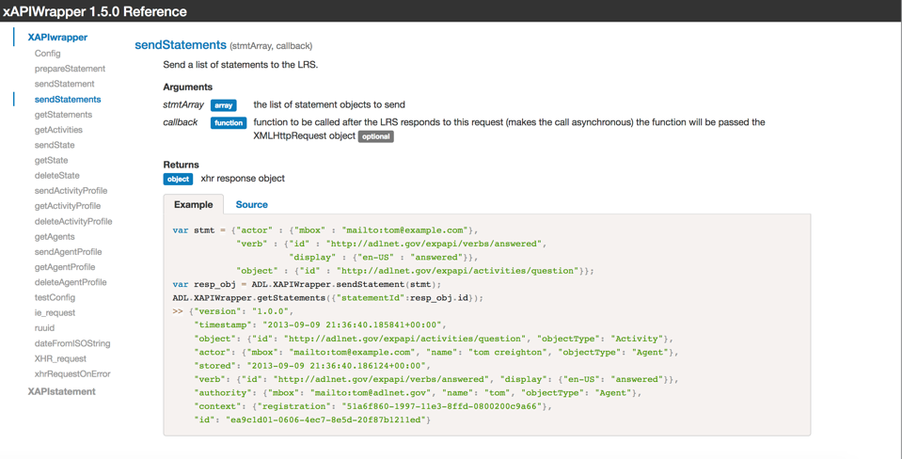

Slide 52
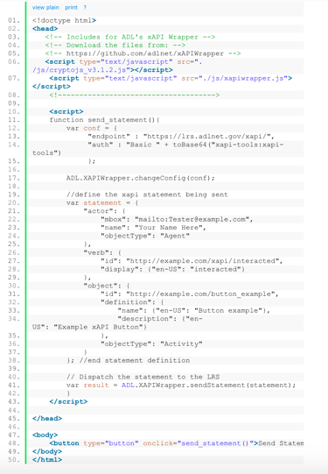
activity: build a LRP
form into groups of at least 2
go to this site: http://www.beyondlms.org/blog/LASIworkshop/
follow its instructions diligently! :P

Slide 53
what did we learn in that exercise?

Slide 54
lunchtime!

Slide 55
section 4: data interoperability

Slide 56
the importance of context for xAPI

Slide 57
the importance of context for xAPI
is it really optional for LA?

Slide 58
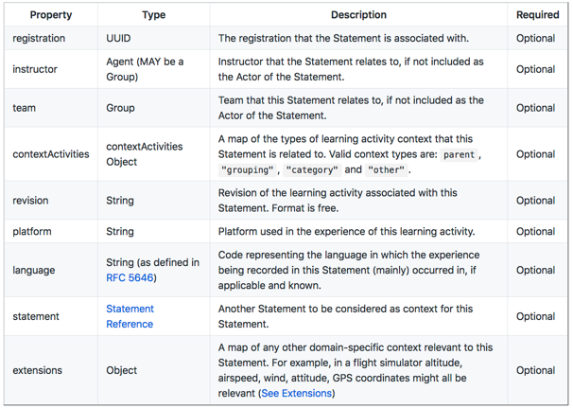
but just how big is a context?
how long might this information need to make sense for?

Slide 59
xAPI profiles for data interoperability
a companion specification to the core xAPI standard
(https://github.com/adlnet/xapi-profiles)
blueprint for a successful, semantically interoperable xAPI implementation… defined by communities of practice
offer a common way to express controlled vocabularies
provide instruction on xAPI Statement formation
describe patterns of xAPI Statements which are meaningful in some way to a profile
extend the notion of xAPI recipes using linked data standards
JSON-LD (to specify the profile)
SKOS (to connect xAPI concepts together)
PROV (to describe provenance of profiles)
SPARQL (to find profiles on the web)

Slide 60
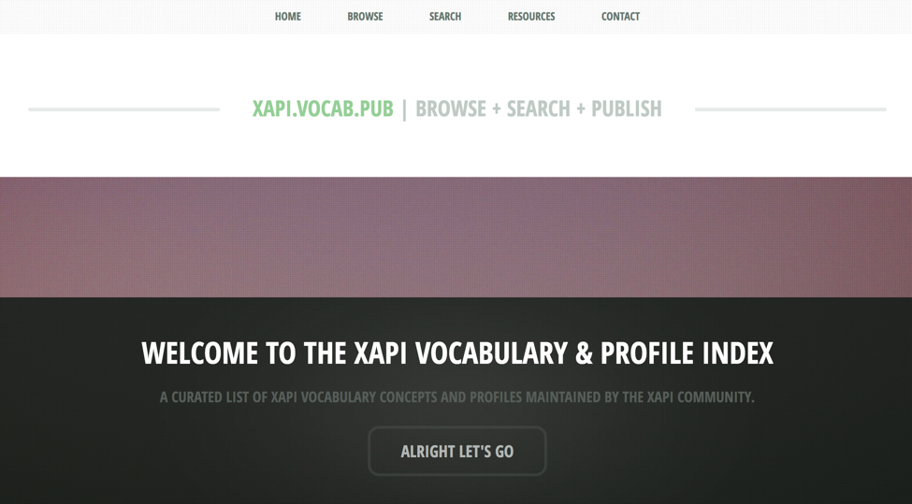
http://xapi.vocab.pub/

Slide 61
the need for xAPI profiles points to a tension!
xAPI Advantages
xAPI Disadvantages
lightweight
development easy!
rapidly extensible to new learning scenarios – someone just needs to write and publish a profile!
easy to share different profile specifications and to see what people are doing
easy to join in and influence dev
it’s the wild west!
poor practices are common
some communities of practice are moving well… but a lot of work remains to be done
without common practices xAPI statements will only ever make sense in the ecosystem where they were defined

Slide 62
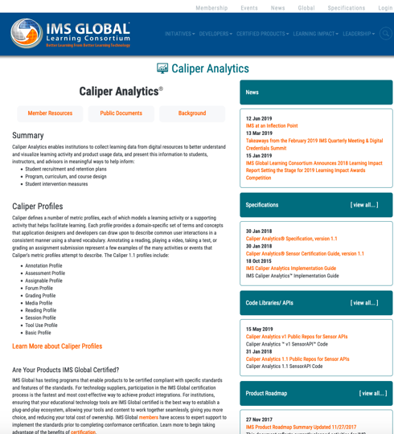
an alternative approach: Caliper
specification released in 2015 https://www.imsglobal.org/activity/caliper
has similar triples to xAPI (actor, action, object)
BUT much stricter about use of metric profiles... data providers must implement at least one (& pay for conformance testing)
open source but dev model is closed – IMS contributing status required

Slide 63
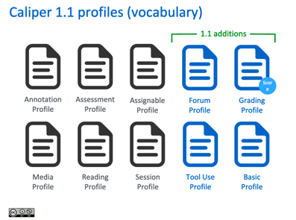
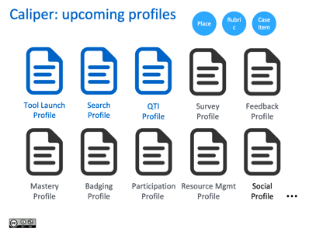
my biggest problem with Caliper
I have no idea what is going on! (not an IMS member)
so I can’t really teach you much… although these slides help! http://www.elearningkorea.org/download2?filename=LASI_Markus_Gylling_mgy-seoul-sep2018.pdf&filesource=LASI_Markus_Gylling_mgy-seoul-sep2018.pdf

Slide 65
but it does raise some interesting issues…
NB: this is not best practice xAPI! Just talking about the base spec!

Slide 66
data interop: big and comprehensive?
or loose and modular?
you could ensure that all educational technology uses one data stack…
but how long would this remain current?
and how quickly will it evolve as new use cases arise?
and who is control of it anyway?
and how comprehensive can this approach actually be?
or you could try and do something that is more modular…
where any LRP can get up and running quickly to provide data
but then you need to ensure that there is a way to map data between different providers

Slide 67
each solution has advantages and disadvantages…
www.allenandallen.com

Slide 68
comparing the two…
xAPI
Caliper
open source with an open dev process
easy to implement
wild west
profiles should be followed
data interoperability follows from best practice adoption
open sourceish - only people with IMS contributing status see all
harder to achieve conformance
stricter
profiles must be followed
data interoperability guaranteed (if people fully implement)
but both require best practice implementation for interoperability… and have problems with generating poor data!

Slide 69
is any of the data currently being generated for LA any good?
?

Slide 70
exercise: start to build an xAPI profile!
Form into groups of >3 and start to work out how you might define an xAPI profile
(Hint: very helpful resources are here: http://xapi.vocab.pub/)
Things you should consider:
start from an educationally meaningful concept (what will you do with the data your profile helps you collect?)
try to use the same terms interchangeably across xAPI and Caliper
try to reuse terms that have already been defined in either spec
it might help to write out a simple xAPI statement first... and then think about what you have to add to it

Slide 71
section 5: poor data (and how to fix it)

Slide 72
data must be cooked with care!
are you capturing all of the relevant data?
is what you are collecting even useful?
or are you just collecting it because you can?
and what metrics are you developing from your data?
Bowker, G. C. (2005). Memory practices in the sciences (Vol. 205). Cambridge, MA: Mit Press.

Slide 73
things can go very wrong with naïve approaches to EdTech
‘‘our combination of leaderboards, badges, and competition mechanics do not improve educational outcomes and at worst can harm motivation, satisfaction, and empowerment’’
(Hanus and Fox, 2015)
Hanus, M. D., & Fox, J. (2015). Assessing the effects of gamification in the classroom: A longitudinal study of intrinsic motivation, social comparison, satisfaction, effort, and academic performance. Computers & Education, 8, 152–161.

Slide 74
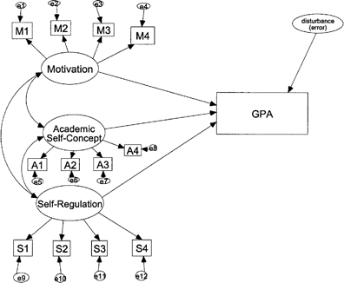
the clicks to constructs problem
low level clickstream data does not necessarily translate into educationally meaningful information
aggregating it is problematic
brute force analysis is hard (and often yields nothing)
many important educational constructs have no obvious clickstream signature
is the data hard to interpret? or is it just not there?
Buckingham Shum, S., & Crick, R. D. (2016). Learning Analytics for 21st Century Competencies. Journal of Learning Analytics, 3(2), 6-21.
Kitto, K., Lupton, M., Davis, K., Waters, Z. (2017). Designing for Student Facing Learning Analytics, Australasian Journal of Educational Technology, 33(5), 152-168.
McCoach, D. B. (2003). SEM Isn't just the Schoolwide Enrichment Model anymore: Structural Equation Modeling (SEM) in gifted education. Journal for the Education of the Gifted, 27(1), 36-61.

Slide 75
creating data for learning analytics ecosystems an emerging white paper for discussion: https://bit.ly/2FePfoU

Slide 76
recommendations for procuring useful EdTech products
Start with a clear vision and applied project for analytics
Require raw data (event-level, streaming) made available outside the application
Include analytics experts in the core team to draft tenders and review responses
Require best practice implementation of standards
Inspect a data sample to ensure useful data is provided
Form a bloc to develop an agenda and reduce required effort

Slide 77
recommendations for EdTech vendors to generate useful data
Educational use cases should drive data generation and analytics, not technology functionality
Follow data standards at best practice level
Implement more than REQUIRED
Pay attention to your competitors data formats and work towards interoperability with them
Prioritize the long term

Slide 78
recommendations for the LA/EDM community
Get involved
Doing your own thing is easier at first… but hurts us all over time
Think about how to scale your research from the outset
We need a scientific community driving standards development

Slide 79
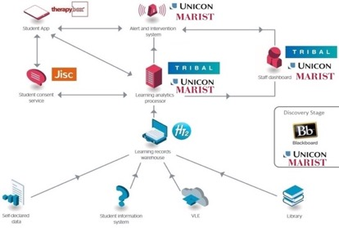
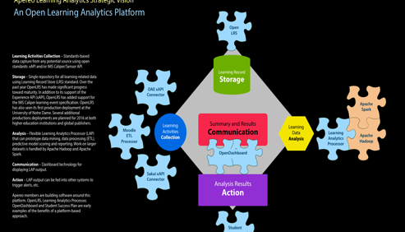
your architecture is more important than you can imagine when you start
(some LA ecosystem architectures currently in use)

Slide 80
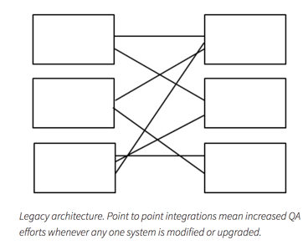
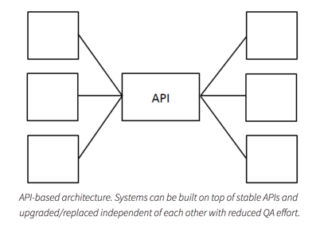
loose couplings need to become the norm
OR
https://edutechnica.com/2015/06/09/flipping-the-model-the-campus-api/

Slide 81
one that I am working on at UTS
http://www.beyondlms.org/tools/LA-API/ has more information

Slide 82
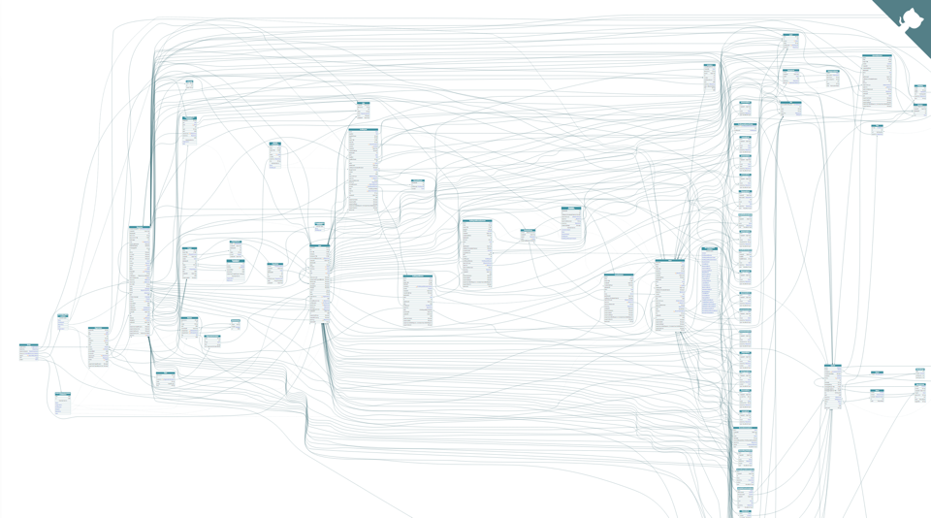
does graphQL help us? (I think yes!)
GraphQL is a query language that enables an abstraction of server-side API calls under a single neat wrapper, instead of to multiple endpoints…
efficient data retrieval - LA applications need to be mobile friendly
flexible - many different applications will need access to student data
strongly typed - clearly defines how the client can access the data, so acts as an intermediate layer between back end complex infrastructure and front end user interfaces
extensible – enables ongoing addition of LA services as necessary

Slide 83
in summary…
if you just collect lots of data with no attention to your ecosystem then you will soon discover that your data is hard to analyse
data interoperability can help here…
but it takes a lot of effort to do well
and its not enough!
to get past the data wall, vendors, people procuring systems, and LA/EDM practitioners must all work together
After the break we will move to an activity – pick a challenge!

Slide 84
section 6: pick a challenge!
Find a challenge that:
appeals to groups of at least 4 people (it could be combination)
design an approach to solving it
see how much you can implement before the end of the day!
NB: you will have to report back!

Slide 85
challenge 1: best practice xAPI profiles
Can you build a profile that will provide data the LA community can actually use?
try to incorporate both xAPI and Caliper terms (interoperability)
this page should be your first port of call: http://xapi.vocab.pub/
resources are here: http://www.beyondlms.org/blog/LASIworkshop/

Slide 86
challenge 2: design an extension to the LA-API schema
Can you extend the LA-API schema design to facilitate more LA?
what data types do you want that it does not have? (that should be easy - it currently only has a few!)
what EdTech tools should these new types be populated with? what analytics should it be possible to build off those types?
resources are here: http://www.beyondlms.org/blog/LASIworkshop/
86

Slide 87
challenge 3: extend the LA-API
Can you fork the LA-API/mongo-extract and extend them to add new functionality
lots of extensions are possible
analytics
dashboards
schema extension
new data sources
see also http://www.beyondlms.org/tools/LA-API/ and http://www.beyondlms.org/tools/CLAtoolkit/

Slide 88
challenge 4: design a dashboard
Can you leverage data interop to build dashboards that self populate using all relevant data?
what advantages do you get out of being able to re-use LA code across applications?
how will the back end talk to the front end?
user configurable or not?

Slide 89
challenge 5: explore the ethics of data interoperability
What might go wrong if data flows across institutional boundaries?
how could we work to stop that from happening?
what vision should we be aiming for?
best practice support? (the obligation to act)
privacy?
ownership?
empowerment?

Slide 90
afternoon tea!

Slide 91
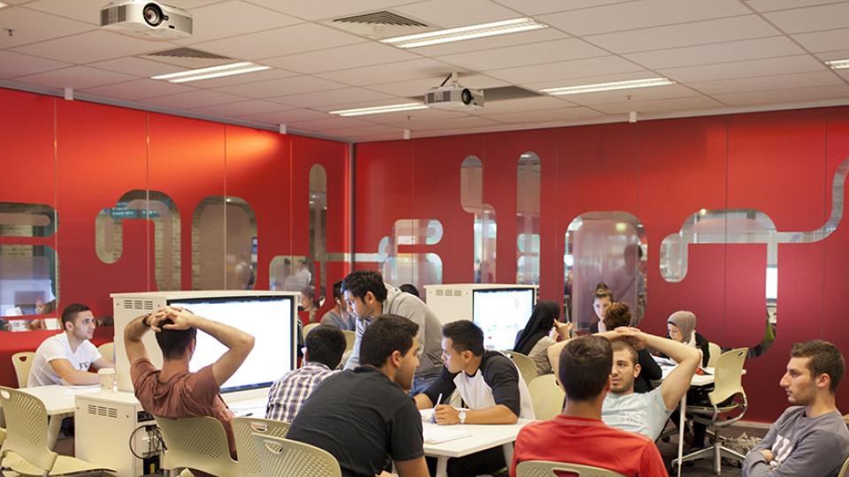
activity: form a group and pick a challenge to work on

Slide 92
reporting back…
what did you learn?
what will you take away?
what won’t you do? (why?)

Slide 93
go forth and conquer! (have fun building the LA ecosystems that we actually need!)
utscic.edu.au

